Slide 1

Network+ Guide to Networks
Chapter 10
TCP/IP and Subnetting

Slide 2
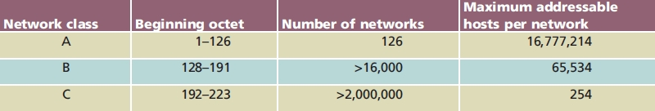
IPv4 Addressing
Table 4-1 Commonly used TCP/IP classes
IP address information
Network Class determined by first octet
Class A, Class B, Class C

Slide 3
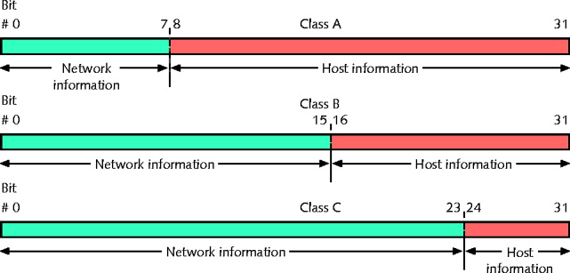
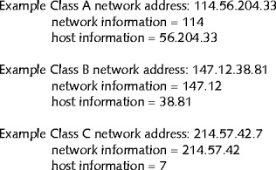
IPv4 Addressing

Slide 4
IPv4 Addressing (cont’d.)
Class A devices
Share same first octet (bits 0-7) as Network ID
Host: second through fourth octets (bits 8-31)
Class B devices
Share same first two octet (bits 0-15): Network ID
Host: second through fourth octets (bits 16-31)
Class C devices
Share same first three octet (bits 0-23): Network ID
Host: second through fourth octets (bits 24-31)

Slide 5
IP Address - Special Cases
127.0.0.0 network is called the loopback address
Loopback test
Attempting to connect to own machine
Powerful troubleshooting tool
IETF reserved addresses for private networks
Class A addresses beginning with 10
Class B addresses from 172.16 to 172.31
Class C addresses from 192.168.0 to 192.168.255
These addresses can’t be routed across the Internet

Slide 6
Binary and Dotted Decimal Notation
Decimal number between 0 and 255 represents each binary octet
Period (dot) separates each decimal
Dotted decimal address has binary equivalent
Converting each octet
Remove decimal points

Slide 7
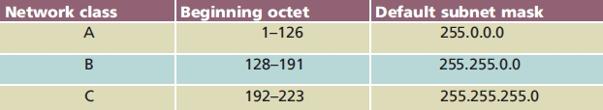
Table 4-2 Default subnet masks
Subnetting
Subdividing network single class into multiple, smaller logical networks (segments)
Control network traffic
Make best use of limited number of IP addresses
Subnet mask varies depending on subnetting
Nonsubnetted networks use defaults

Slide 8
Subnetting
Separates network
Multiple logically defined segments (subnets)
Geographic locations, departmental boundaries, technology types
Subnet traffic separated from other subnet traffic
Reasons to separate traffic
Enhance security
Improve performance
Simplify troubleshooting

Slide 9
Classful Addressing in IPv4
Figure 4-8 IP addresses and their classes
First, simplest IPv4 addressing type
Adheres to network class distinctions
Recognizes Class A, B, C addresses

Slide 10
Classful Addressing in IPv4 (cont’d.)
Network information (network ID)
First 8 bits in Class A address
First 16 bits in Class B address
First 24 bits in a Class C address
Host information
Last 24 bits in Class A address
Last 16 bits in Class B address
Last 8 bits in Class C address

Slide 11
Classful Addressing in IPv4 (cont’d.)
Figure 10-1 Example IPv4 addresses with classful addressing

Slide 12
Classful Addressing in IPv4 (cont’d.)
Drawbacks
Fixed network ID size limits number of network hosts
Difficult to separate traffic from various parts of a network

Slide 13
IPv4 Subnet Masks
Identifies how network subdivided
Indicates where network information located
Subnet mask bits
1: corresponding IPv4 address bits contain network information
0: corresponding IPv4 address bits contain host information

Slide 14
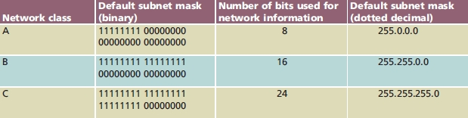
IPv4 Subnet Masks (cont’d.)
Table 10-1 Default IPv4 subnet masks
Default subnet mask uses a 255 in each octet of the address that corresponds to the network portion and a zero in each octet that corresponds to the host portion.

Slide 15
Reserved Addresses
Cannot be assigned to node network interface; used as subnet masks
Network ID
Bits available for host information set to 0
Classful IPv4 addressing network ID ends with 0 octet
Subnetting allows network ID with other decimal values in last octet(s)
Broadcast address
Octet(s) representing host information equal all 1s
Decimal notation: 255

Slide 16
IPv4 Subnetting Techniques
Subnetting breaks classful IPv4 addressing rules
IP address bits representing host information change to represent network information
Reduce usable host addresses per subnet
Hosts, subnets available after subnetting related to host information bits borrowed

Slide 17
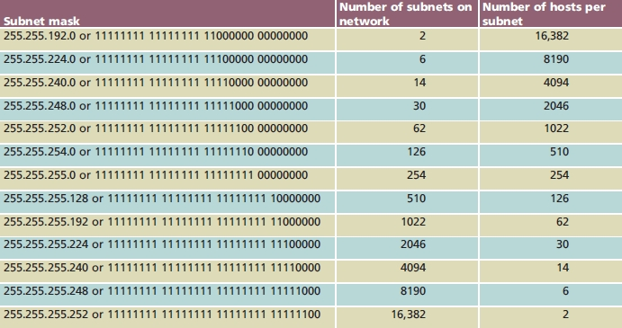
IPv4 Subnetting Techniques (cont’d.)
Table 10-3 IPv4 Class B subnet masks

Slide 18
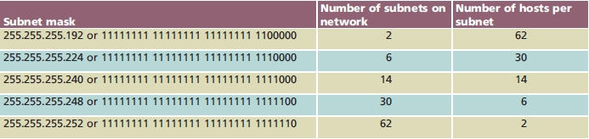
IPv4 Subnetting Techniques (cont’d.)
Table 10-4 IPv4 Class C subnet masks
Class C network
Fewer subnets than Class B
Same number of hosts per subnet as Class B

Slide 19
Calculating IPv4 Subnets
Formula: 2^{n} −2=Y
n: number of subnet mask bits needed to switch
From 0 to 1
Y: number of resulting subnets
Example
Class C network
Network ID: 199.34.89.0
Want to divide into six subnets

Slide 20
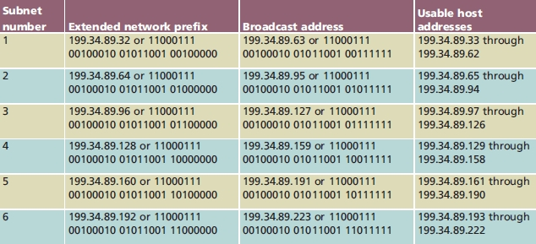
Calculating IPv4 Subnets (cont’d.)
Table 10-5 Subnet information for six subnets in an example IPv4 Class C network

Slide 21
Calculating IPv4 Subnets (cont’d.)
Class A, Class B, and Class C networks
All can be subnetted
Each class has different number of host information bits usable for subnet information
Varies depending on network class and the way subnetting is used
LAN subnetting
LAN’s devices interpret device subnetting information
External routers need network portion of device IP address

Slide 22
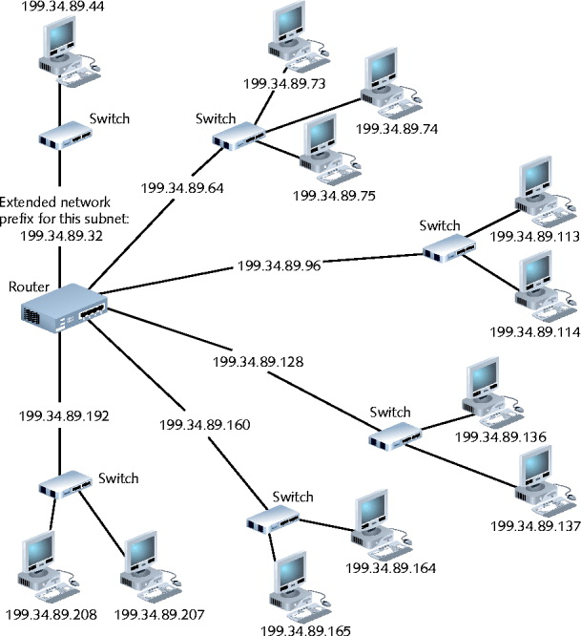
Figure 10-3 A router connecting several subnets

Slide 23
Calculating Supernets
Supernetting “borrows” bits from network portion of an IP address to “lend” those bits to host portion
Permits consecutive IP network addresses to be combined and viewed in a single logical network
Combining two or more small networks into one larger network is only one reason to supernet
Supernetting can combine multiple routing table entries into a single entry, which can drastically decrease the table’s size on Internet routers
This reduction in routing table size increases the speed and efficiency of Internet routers
Notes:
Say you have three class C network addresses 192.168.0.0 192.168.1.0 192.168.2.0 and 192.168.3.0
You have 900 hosts on the network
Combine the 4 networks by borrowing bits from the network side to combine the networks need 2 bits (2^2 = 4)
192.168.0.0 as network address with subnet 255.255.252.0 (255.255.11111100.0)
Now you have 10 bits for the host portion instead of 8 so number of hosts = 2^10 – 2 = 1022 so you can have 900 hosts on the network
Routing table == table of networks Internet routers can have huge routing table
Supernetting combines multiple routing table entries into one so reduces search time and table size

Slide 24
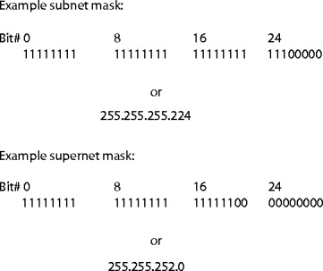
CIDR (cont’d.)
Figure 10-4 Subnet mask and supernet mask

Slide 25
CIDR Notation
CIDR notation (or slash notation)
Shorthand denoting subnet boundary position
Form
Network ID followed by forward slash ( / ), followed by number of bits used for extended network prefix
i.e. CIDR of 192.168.100.0/26 would indicate a class C subnetted address using 26 bits for the network address and thus only 6 for the host.
CIDR block
Forward slash, plus number of bits used for extended network prefix

Slide 26
Network Address Translation (NAT)
Notes:
Sub and super netting helps alleviate, but simply are more efficient use of IP addresses
NAT allows an organization to have their own private IP addresses while connected to the internet
Same IP addresses within the company
Only need public IP address when going to world…reduces number of public IP addresses dramatically
Also PAT (Port Address Translation) that uses port numbers and shares a single IP address; send the port address with the request and the PAT table takes care of setting up the proper address (ports 1024 to 65535)

Slide 27
Internet Protocol Version 6 (IPv6)
IPv6 solves several IPv4 problems
Limiting 32-bit address space
An IPv6 address is 128 bits long
Lack of built-in security
IPSec provides authentication and encryption
A sometimes complicated setup
IPv6 is autoconfiguring (stateless or stateful)
Lack of built-in QoS
QoS headers in IPv6 packets can identify packets that require special or priority handling, making applications such as streaming audio and video much easier to implement

Slide 28
IPv6
IPv6 uses a 128-bit address, allowing for 2¹²⁸, or approximately 3.4×10³⁸ addresses, or more than 7.9×10²⁸ times as many as IPv4, which uses 32-bit addresses.
IPv4 allows for only approximately 4.3 billion addresses.
The two protocols are not designed to be interoperable, complicating the transition to IPv6.
IPv6 addresses consist of eight groups of four hexadecimal digits separated by colons, for example 2001:0db8:85a3:0042:1000:8a2e:0370:7334

Slide 29
IPv6 Addresses
IPv6 address notation:
Longhand notation: 2001:260:0:0:0:2ed3:340:ab
Shorthand notation: 2001:260::2ed3:340:ab
If one of the 16-bit numbers doesn’t require four hexadecimal digits, the leading 0s are omitted
Addresses have a three-part addressing hierarchy
A public topology (first three 16-bit sections)
A site topology (next 16 bits)
An interface identifier (last 64 bits)
Derived from the MAC address on the host’s NIC

